Slide 1
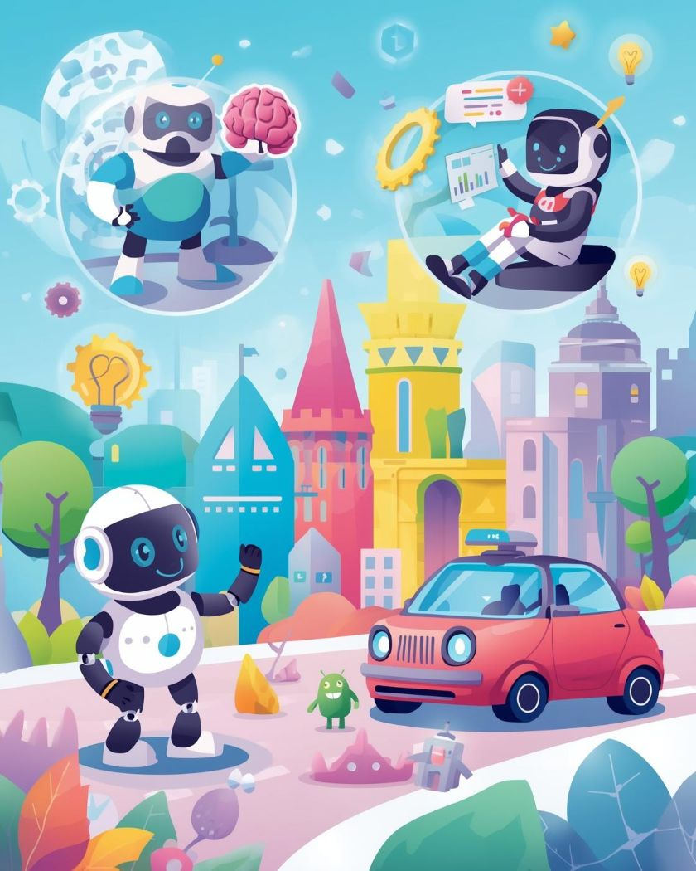
Introduction to AI
Teaching Machines to Think
Presented by,
Zarin Tasnim Uddin Jeba
Presented to,
Mr. Razorshi Prozzwal Talukder
Lecturer
Department of CSE
North East University, Bangladesh

Slide 2

Introduction to AI
Discover how machines learn and think like humans.
2

Slide 3
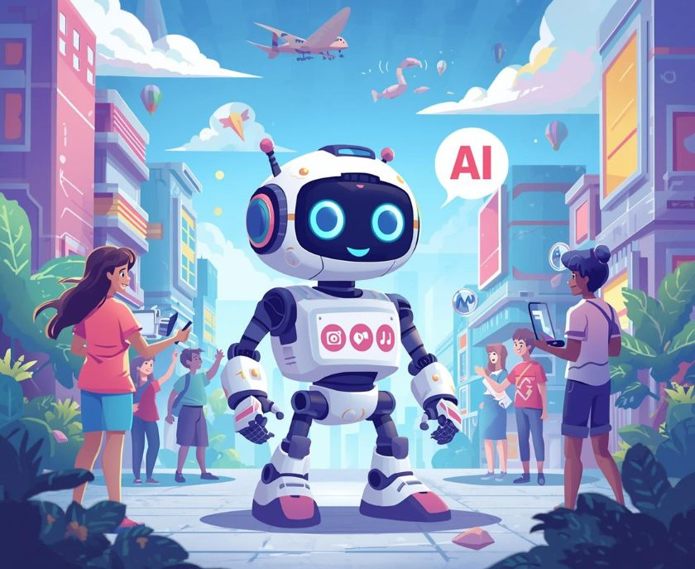
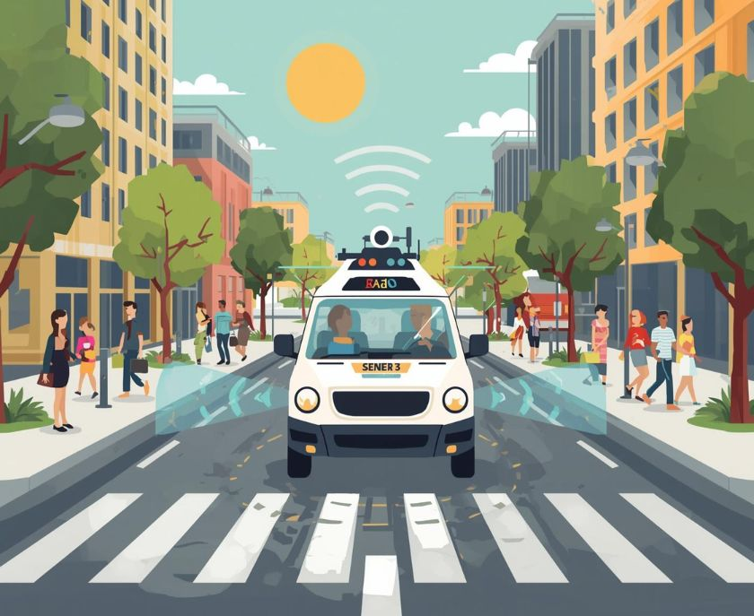
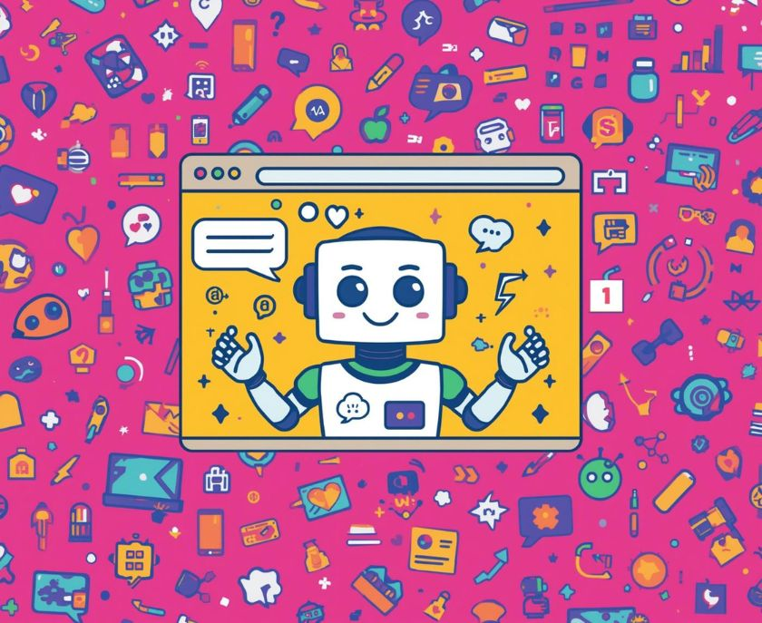
AI in Action
Robot
Self-Driving Car
Chatbot
Friendly robots are helping us every day.
Autonomous vehicles make travel safer and easier.
Chatbots provide quick answers and support online.
3

Slide 4
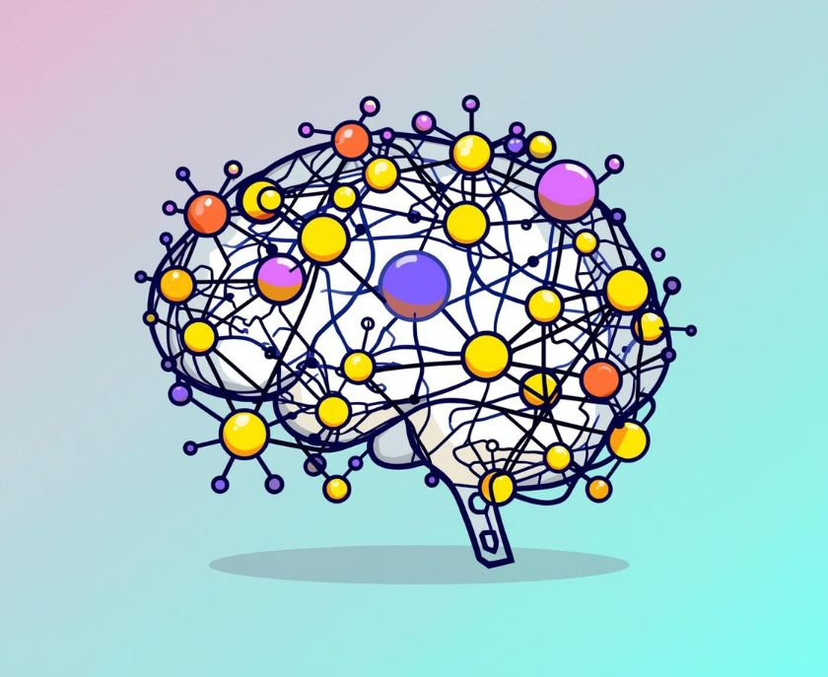
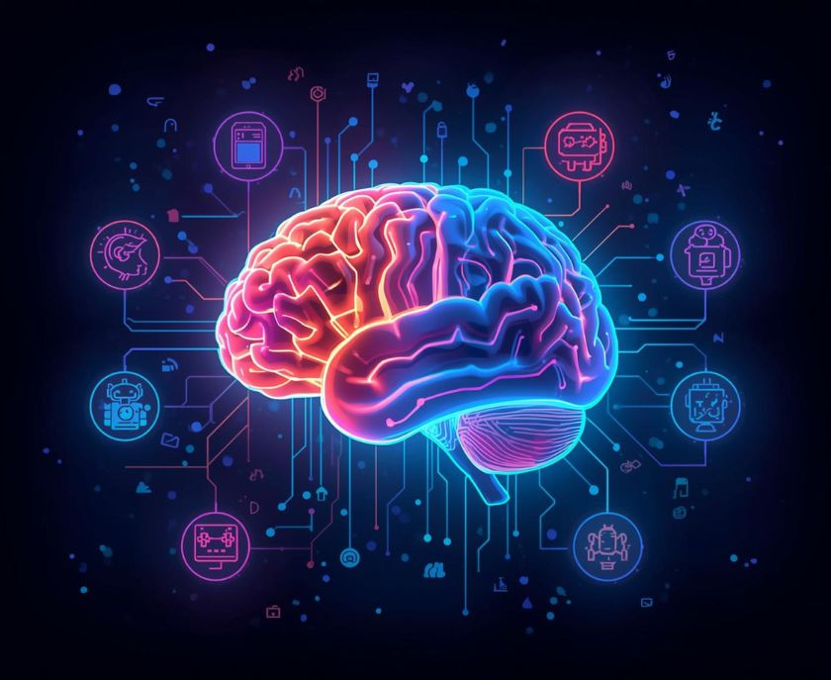
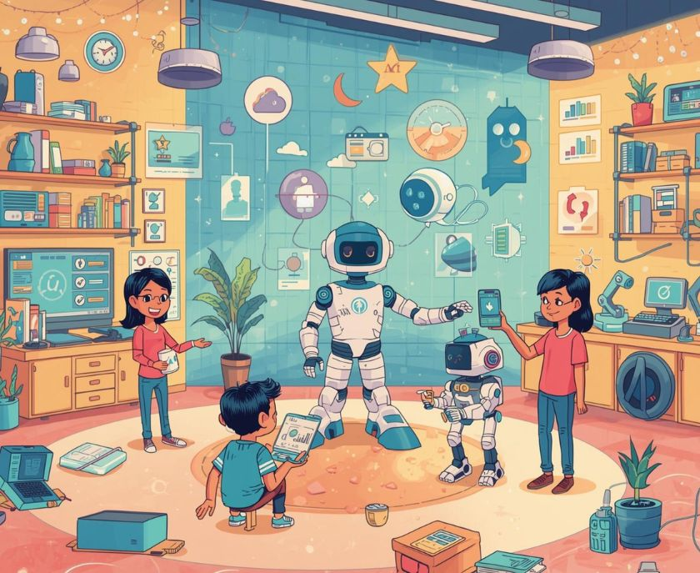
AI Networks and Digital Brains
Neural Network
Digital Brain
AI in Life
AI simulates human brain connections through networks.
Enhanced learning capabilities through digital brain technology.
AI technologies improve daily activities and interactions.
4

Slide 5
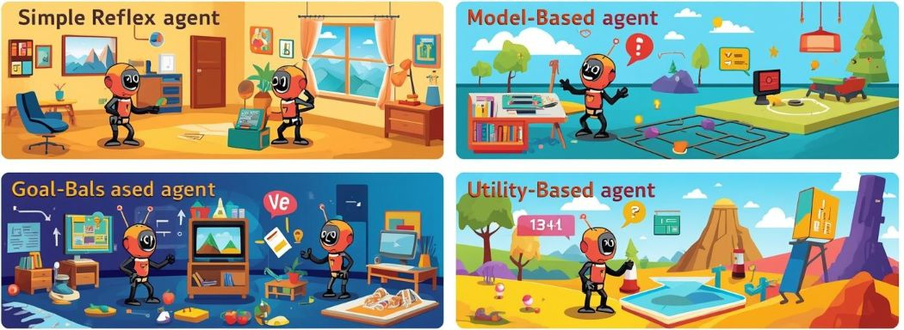
AI Agents Overview
Agents interact with environments to make decisions.
5

Slide 6
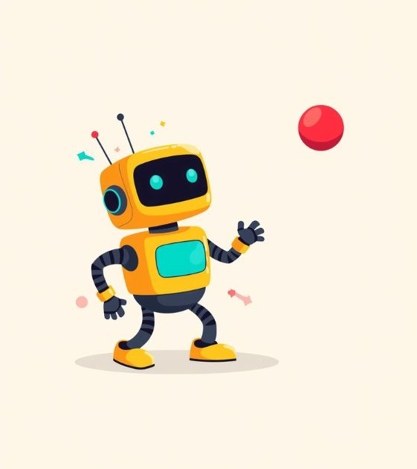
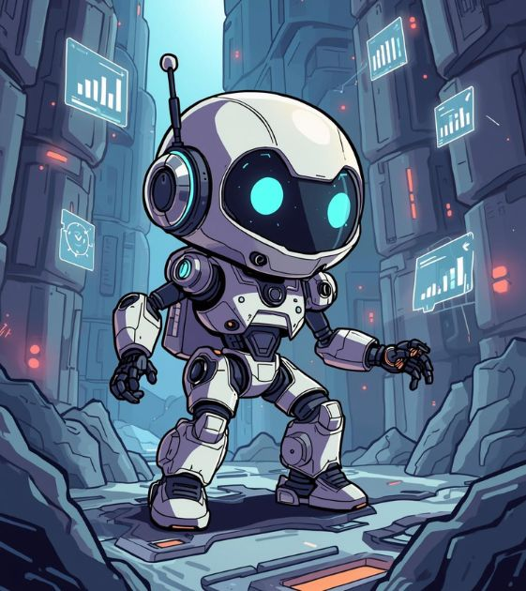
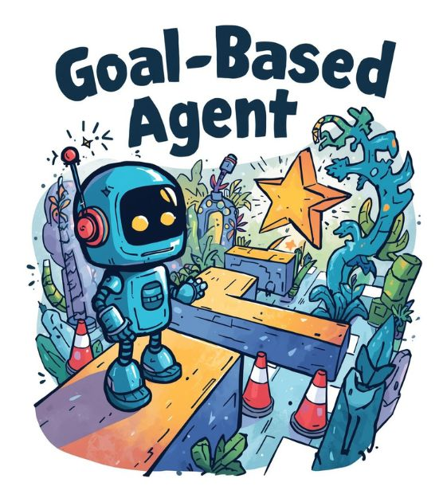
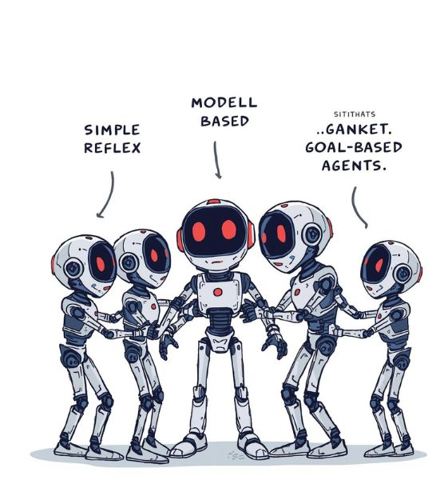
AI Agents Overview
Simple Reflex
Model-Based
Goal-Based
Collaborative Agents
Reacts to stimuli based on simple rules.
Uses internal models to understand its environment.
Makes decisions to achieve specific goals.
Different agents working together for better outcomes.
6

Slide 7
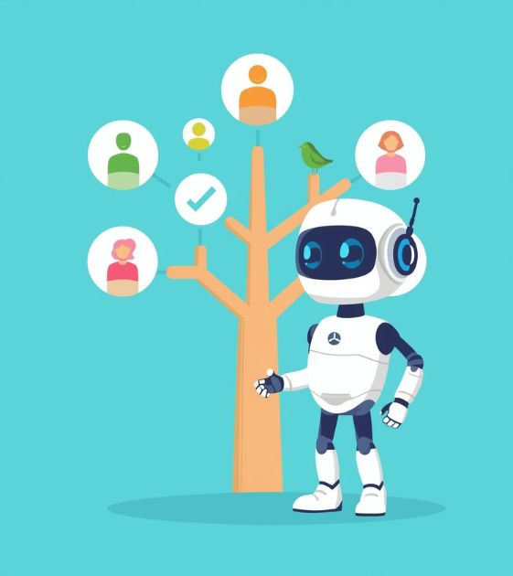



Understanding AI Agents
Utility Agent
Static Environment
Dynamic Environment
Deterministic vs. Stochastic
Utility-based agents make decisions based on preferences.
Static environments have unchanging conditions for agents.
Dynamic environments constantly change and require adaptation.
Deterministic environments offer predictable results; stochastic do not.
7

Slide 8
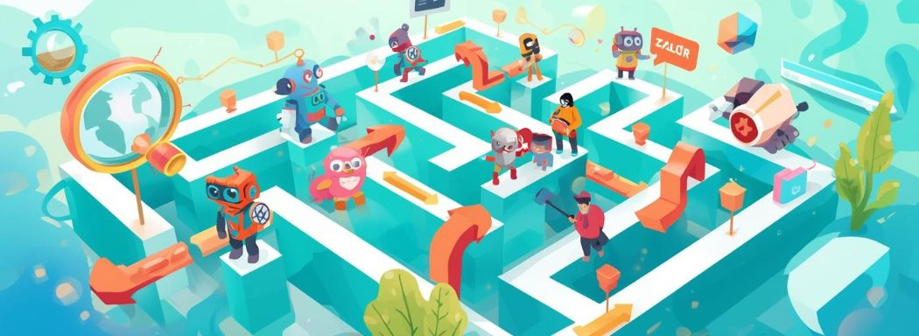
Search Algorithms
Discover how algorithms efficiently find solutions in AI.
8

Slide 9
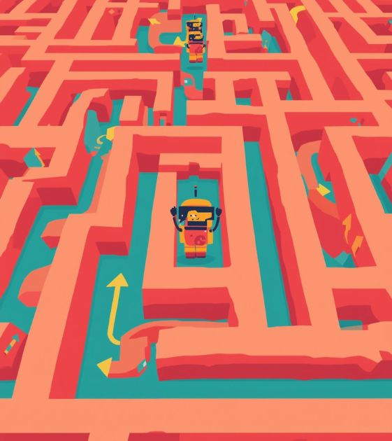

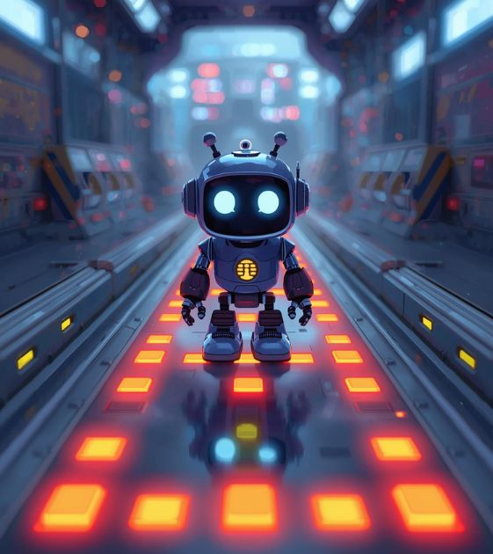
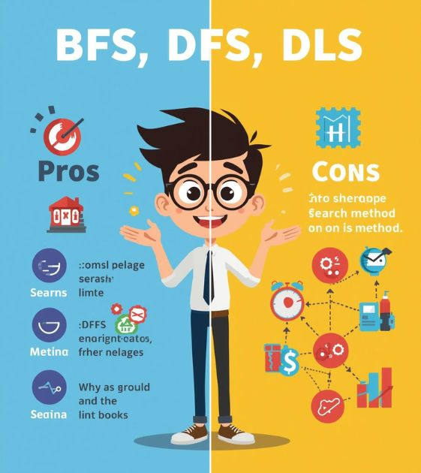
Uninformed Search Methods
Breadth-First
Depth-First
Depth-Limited
Comparison
Explores all neighbors before deeper paths.
Follows a single path to its end first.
Restricts depth to control search space.
Highlights differences of search strategies visually.
9

Slide 10
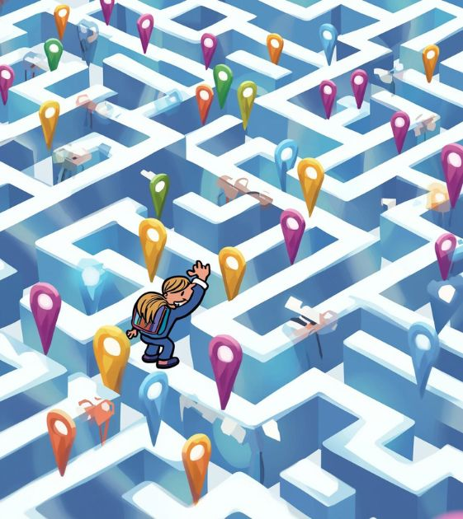

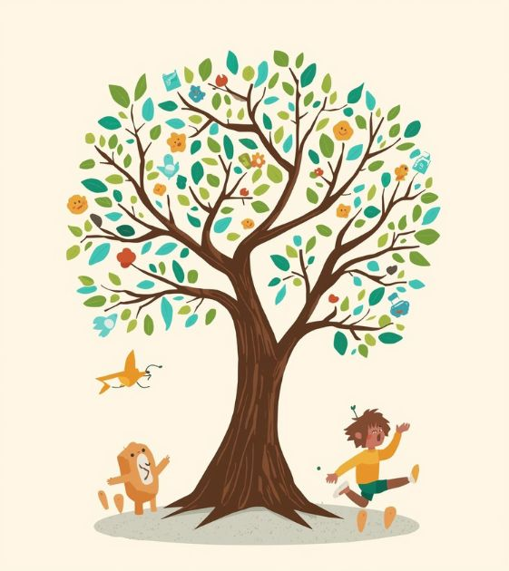
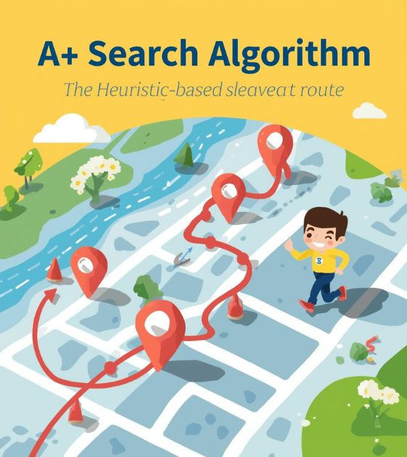
Search Algorithms
Iterative Deepening
Bidirectional Search
Tree Structure
A* Algorithm
IDS combines depth-first and breadth-first techniques efficiently.
This method searches from both ends for faster results.
Visualizes nodes expanding during uninformed search exploration.
A* finds the shortest path using heuristic guidance.
10

Slide 11
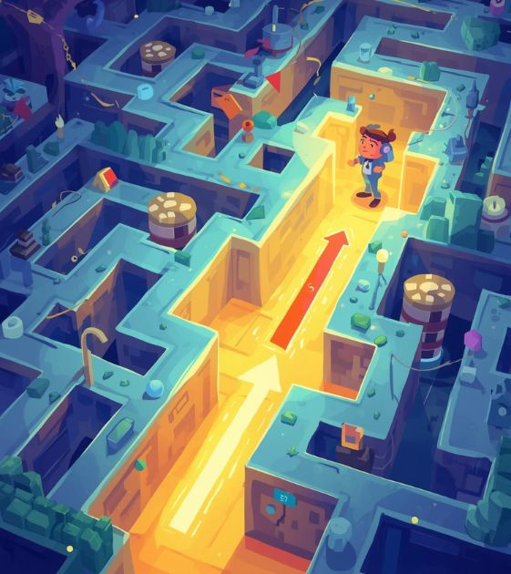
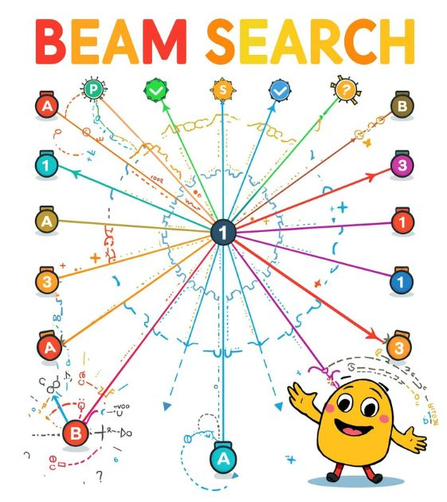

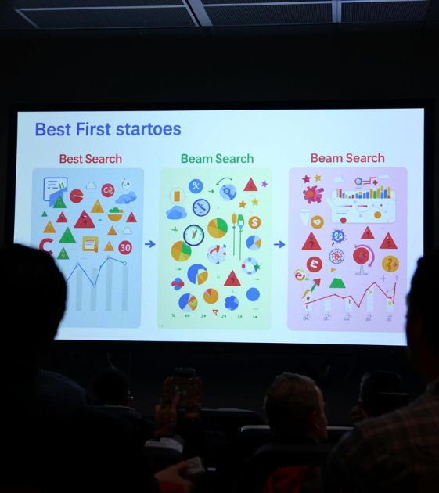
Informed Search Algorithms
Best First
Beam Search
A* Algorithm
Summary
This method prioritizes paths based on estimated costs.
A selective approach keeping a limited number of paths.
Combines cost and heuristic for optimal pathfinding.
Informed searches enhance efficiency and effectiveness significantly.
11

Slide 12
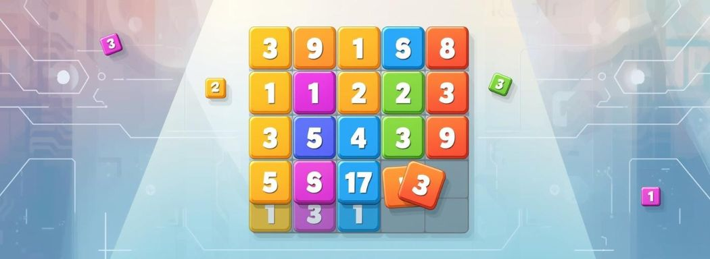
The 8-Puzzle Problem
Discover how algorithms solve this engaging challenge.
12

Slide 13
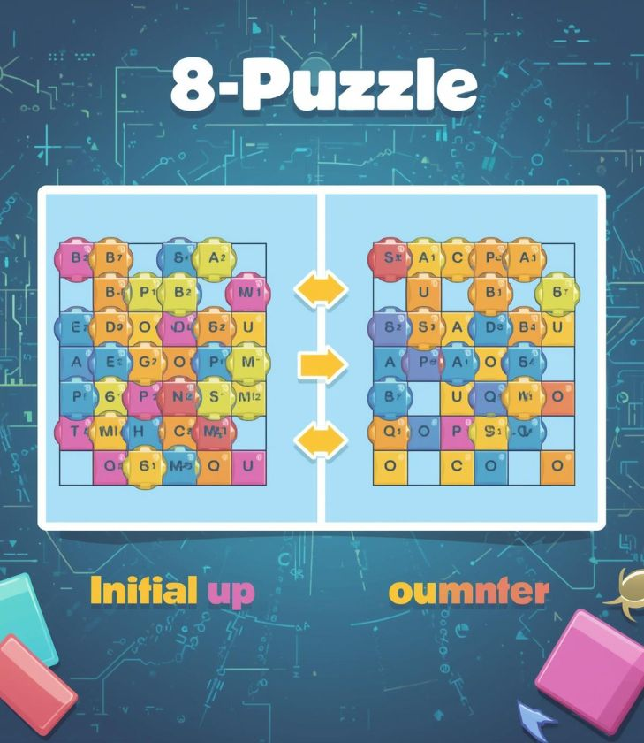
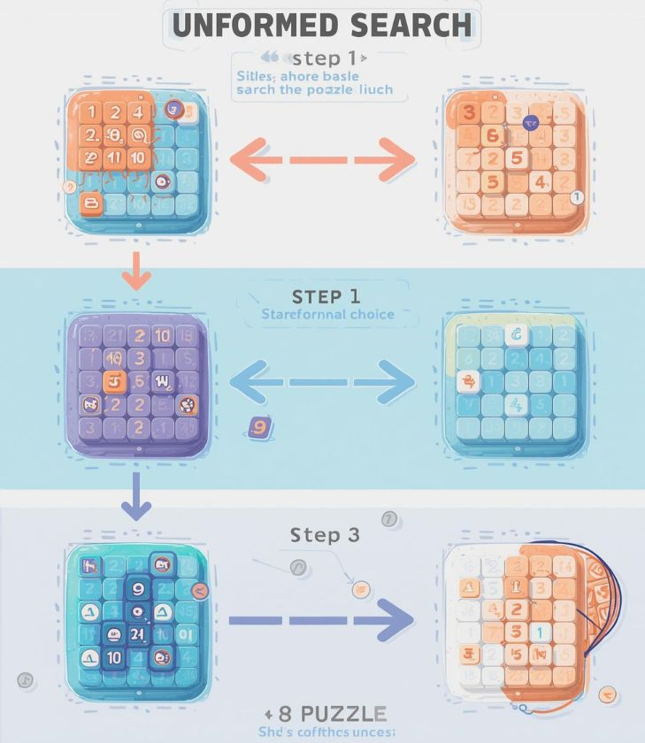
Solving the 8-Puzzle
Initial State
Solving Process
The scrambled 8-Puzzle setup before solving begins.
Animated tiles show the decision-making steps in solving.
13

Slide 14
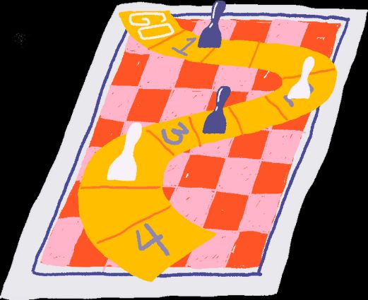
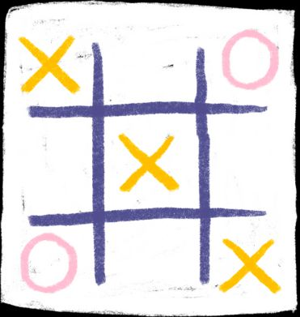

Game-Playing Algorithms
Understanding Minimax and Alpha-Beta Pruning
Minimax and alpha-beta pruning are key AI techniques for optimizing game strategies. Minimax seeks the best move by assuming optimal opponent play, while alpha-beta pruning speeds up this process by ignoring irrelevant game branches.
14

Slide 15
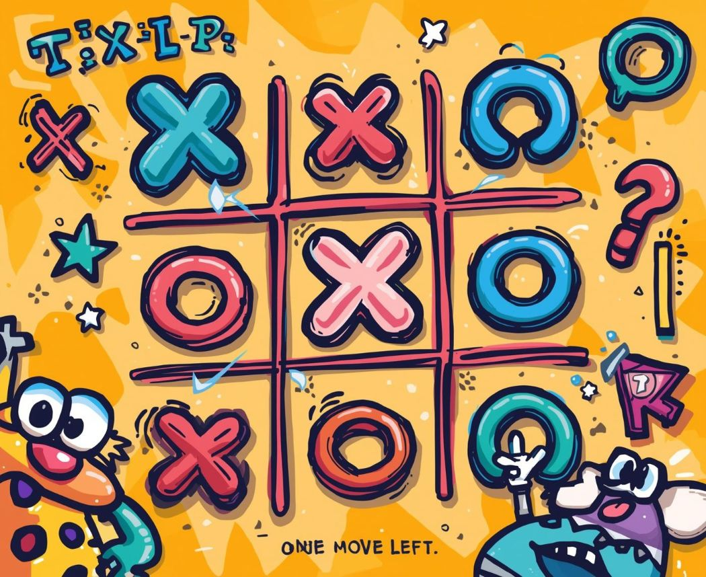
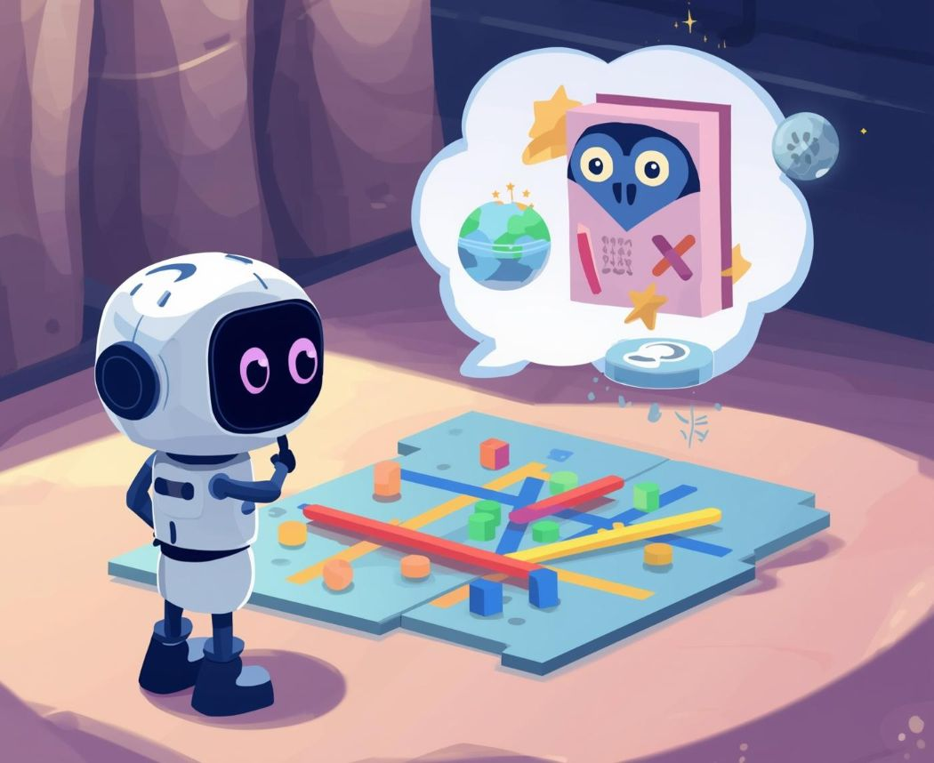
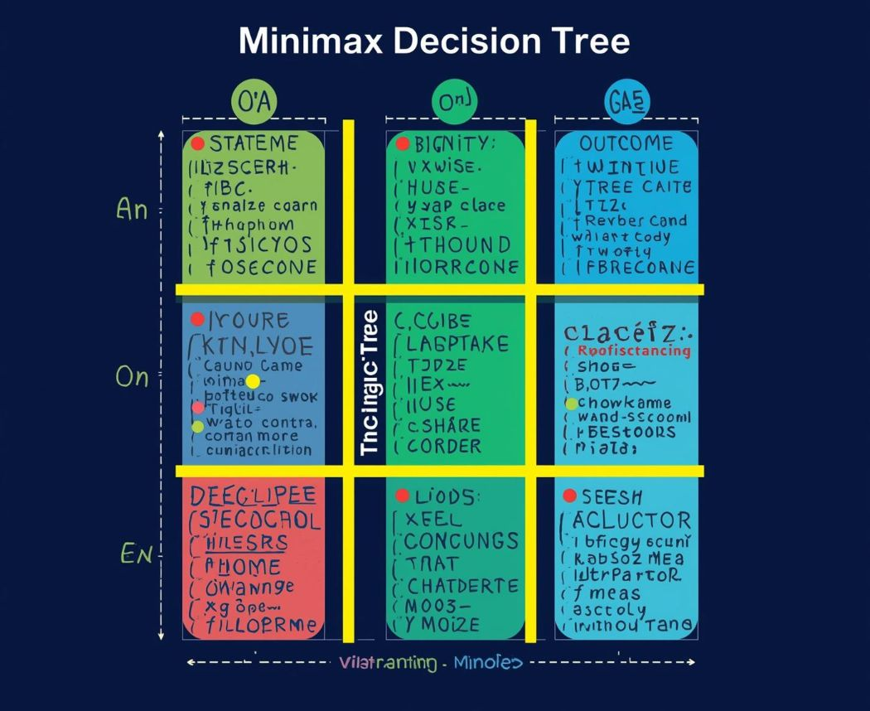
Minimax Algorithm in Action
How AI Plays Tic-Tac-Toe
The Minimax algorithm strategically evaluates possible moves in Tic-Tac-Toe, aiming to maximize the player's chances of winning while minimizing the opponent's options, ensuring optimal gameplay.
15

Slide 16

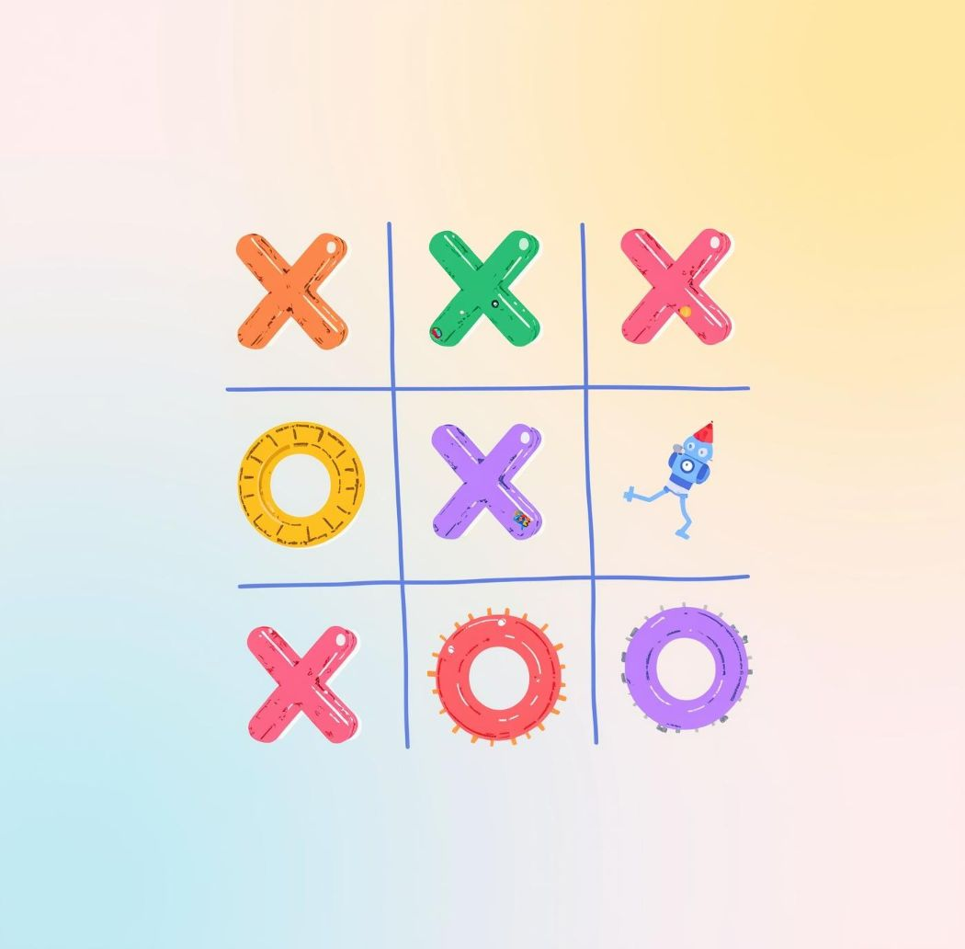
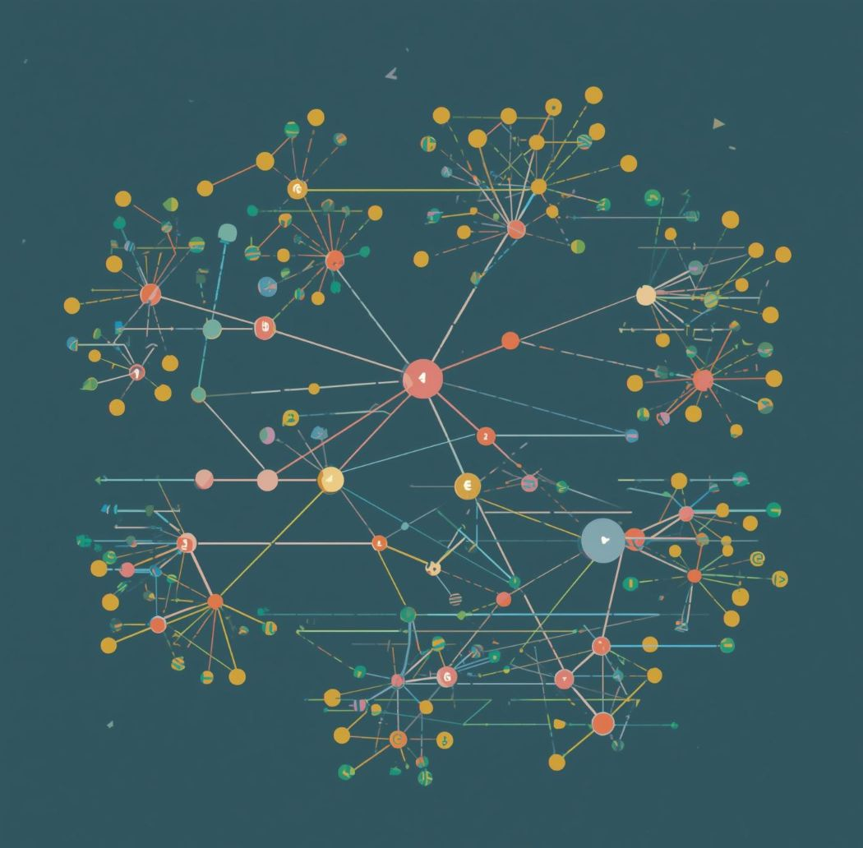
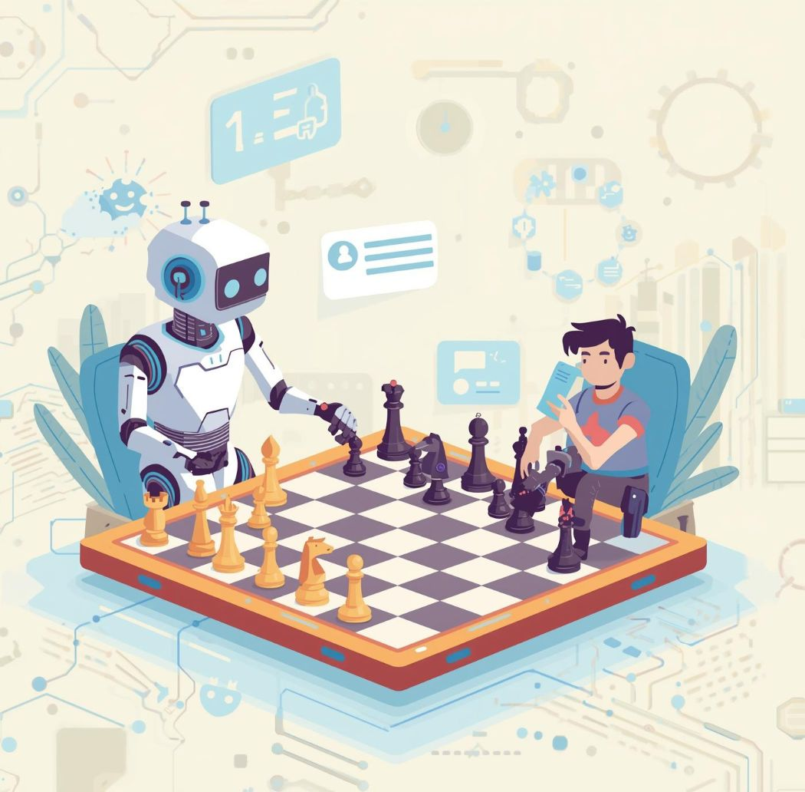
Alpha-Beta Pruning
A technique that optimizes decision-making in game-playing algorithms by reducing branches explored.

Slide 17
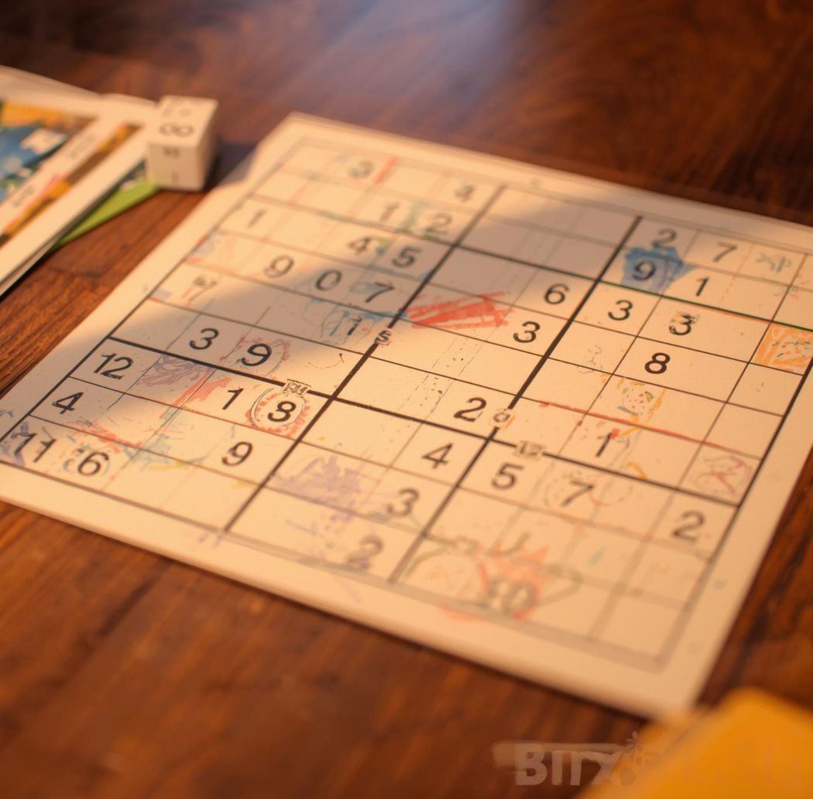
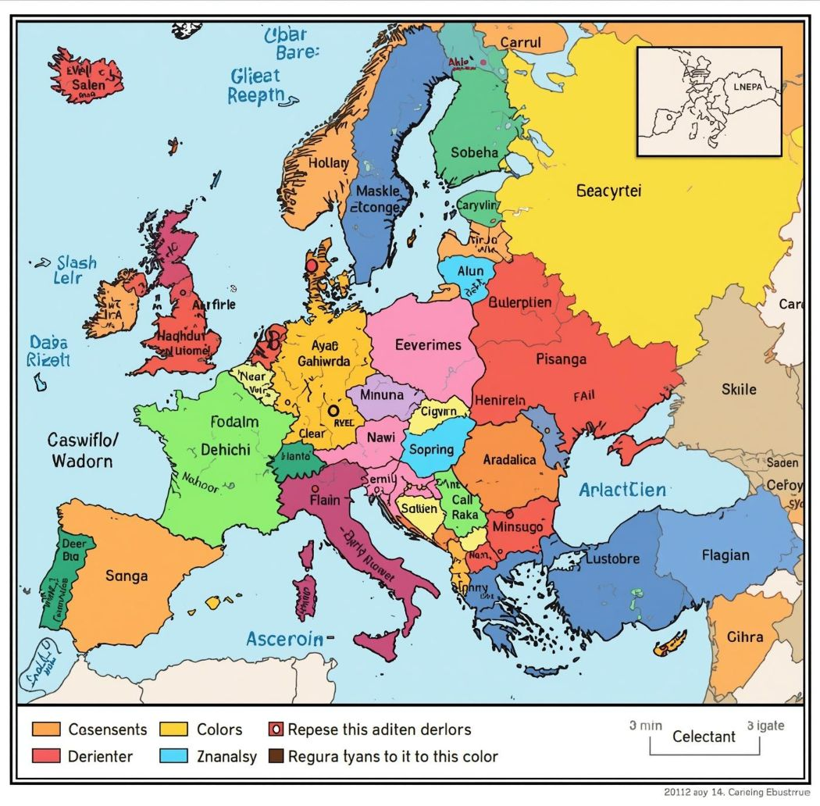

CSPs -Constraint Satisfaction Problems
Constraint Satisfaction Problems involve finding solutions through constraints like in Sudoku or coloring.

Slide 18
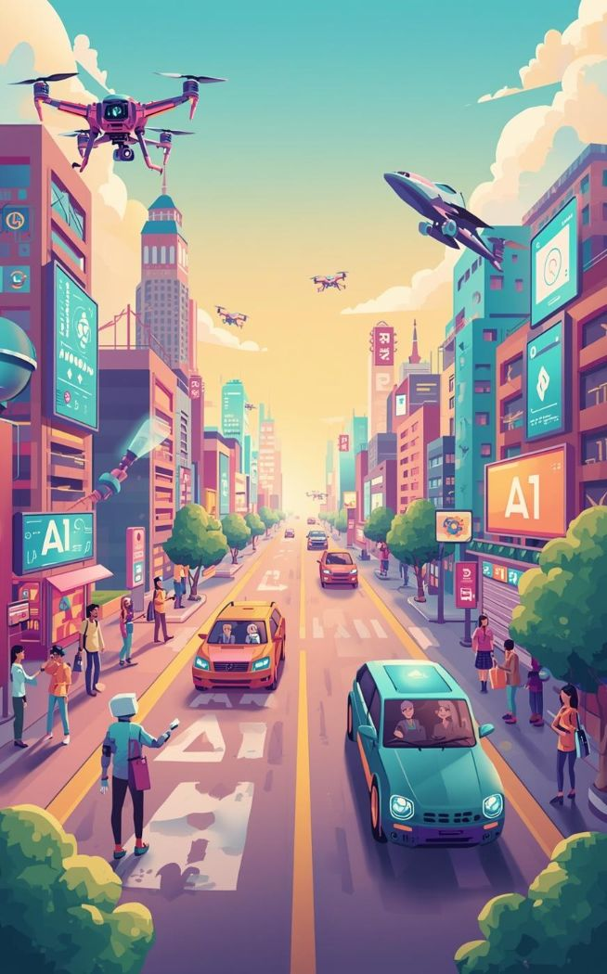
AI's future promises to transform our lives and industries. Advancements could lead to autonomous systems in healthcare, transportation, and more. Ethical considerations will be crucial for responsible AI development.

Slide 19

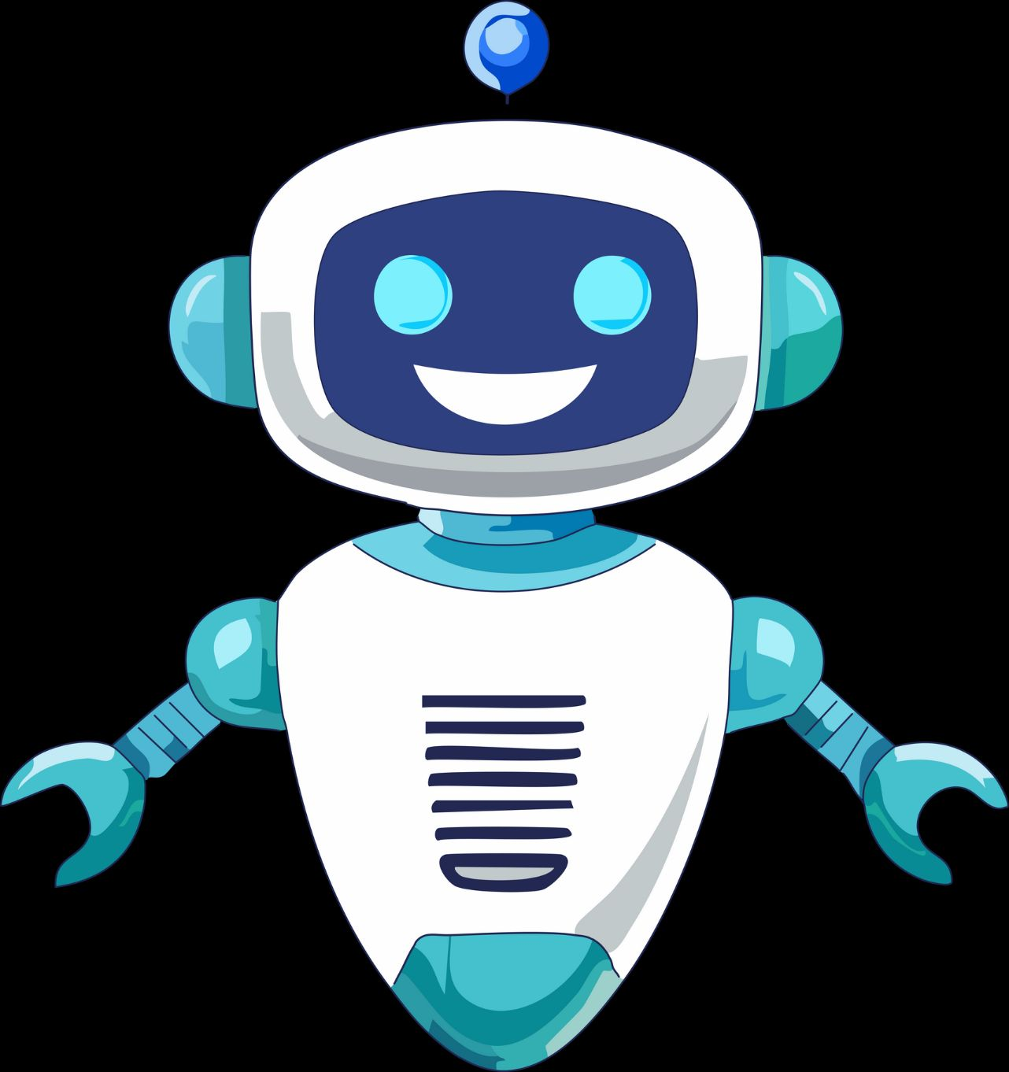
Thank you !

